Slide 1
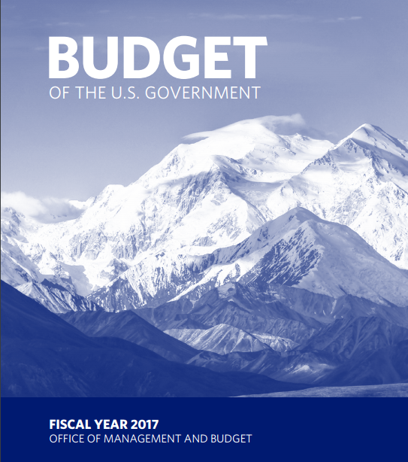
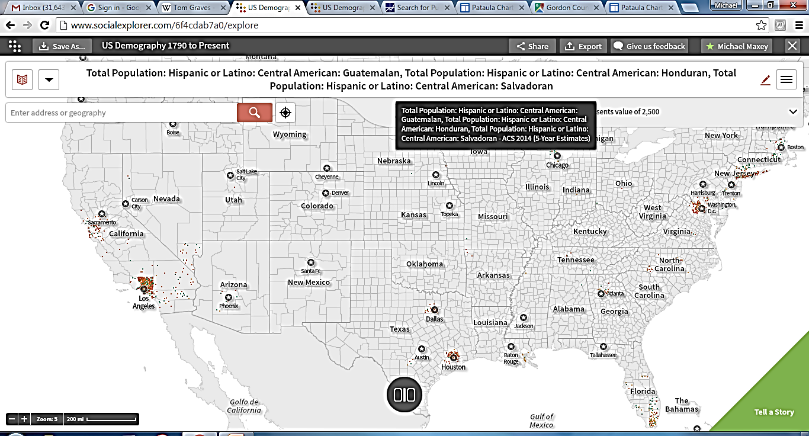
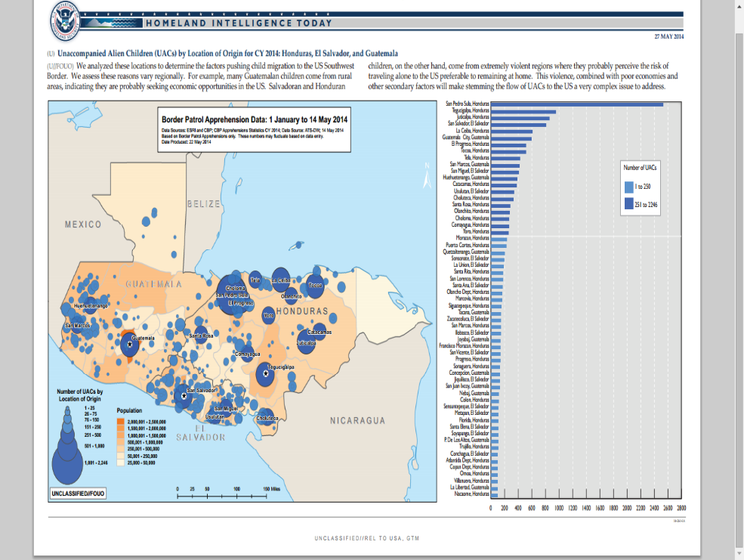
U.S. Budget Process, International Affairs – 150 Account,
& Central America Engagement Strategy
Central American Migration
to the United States
https://www.whitehouse.gov/sites/default/files/omb/budget/fy2017/assets/budget.pdf

Slide 2
Presentation Objectives
Provide an overview of the U.S. government budget process.
Summarize strategy and funding for International Affairs 150 Account.
Examine a specific foreign policy issue – Central American immigration to the US.
Notes:
Economic Development Advisor (1983 - 2013) with USAID serving in Barbados, Honduras, Costa Rica, Peru, Nicaragua, Iraq, West Bank Gaza, and Yemen.
Senior Officer in Charge, Central America Office, USAID Washington DC (2003 - 2007) providing program and strategy development support, and also undertook a one year detail assignment with the Millennium Challenge Corporation.
Private Consultant (2013 - present) providing program design and evaluation services with a specific focus on Unaccompanied Alien Children (UAC) immigration issue. Conducted briefings with Congressional staff in 2013 and 2014 on the need for additional foreign assistance to Central America.

Slide 3
Legal Framework for Budget Process
U.S. Constitution – Article 1, Section 8, Clause 1 & Section 9, Clause 7
Budget & Accounting Act of 1921
Congressional Budget Act of 1974
Balanced Budget and Emergency Deficit Act of 1985
Pay As You Go Act of 2010
Notes:
Article 1, Section 8 Clause 1: “The Congress shall have the power to lay and collect taxes, duties, imposts and excises, to pay the debts and provide for the common defense and general welfare of the United States …” RAISE REVENUE – COLLECT TAXES
Article 1 Section 9 Clause 7: “No money shall be drawn from the treasury, but in consequence of appropriations made by law …” APPROPRIATIONS PRIOR TO DISBURSEMENT OF US GOVT FUNDS
Budget & Accounting Act of 1921 – Three major actions: (1) Established the Executive Branch budget process; (2) Created the Office of Management and Budget (OMB); and
(3) Created the General Accounting Office (now called the General Accountability Office).
Congressional Budget Act of 1974 – Two major actions: (1) Established the Congressional budget process, and (2) Established the Congressional Budget Office.
Balanced Budget and Emergency Deficit Act of 1985 –
Pay As You Go Act of 2010 -

Slide 4
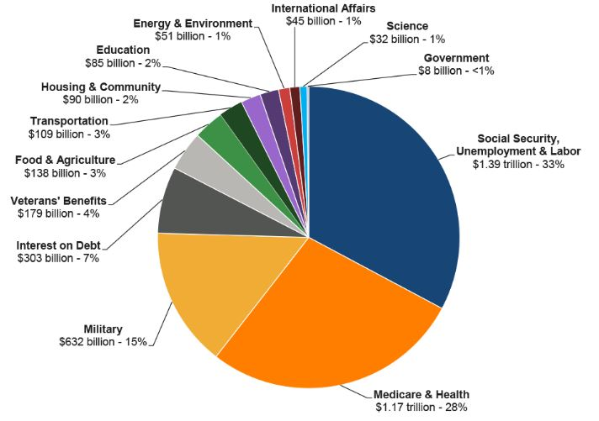
President Obama’s 2017 Budget Request - $4.2 Trillion
Mandatory
Funding –
$2.8 Trillion
Discretionary Funding –
$1.3 Trillion
Source: http://www.NationalPriorities.org

Slide 5
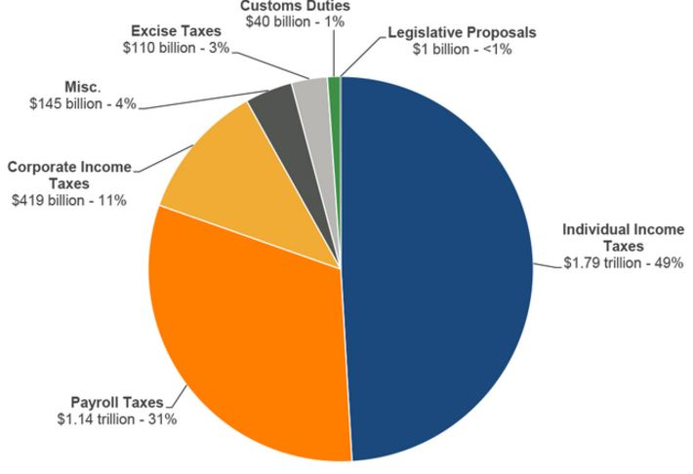
President Obama’s 2017 Budget Proposed Revenue - $3.5 Trillion
Source: http://www.NationalPriorities.org

Slide 6
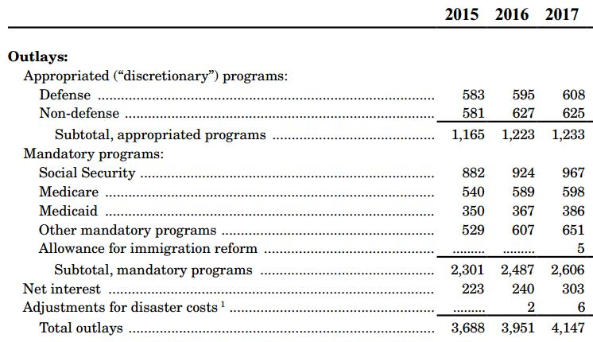
President Obama’s Budget Request

Slide 7
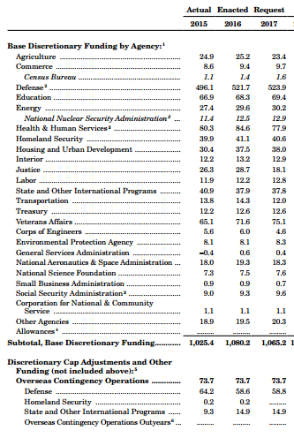
President Obama’s Budget Request by Agency
State Department, Foreign Operations, and Related Programs:
Discretionary Funding - $37.8 billion; and
Overseas Contingency Operations - $14.9 billion.
Total - $52.8 billion

Slide 8
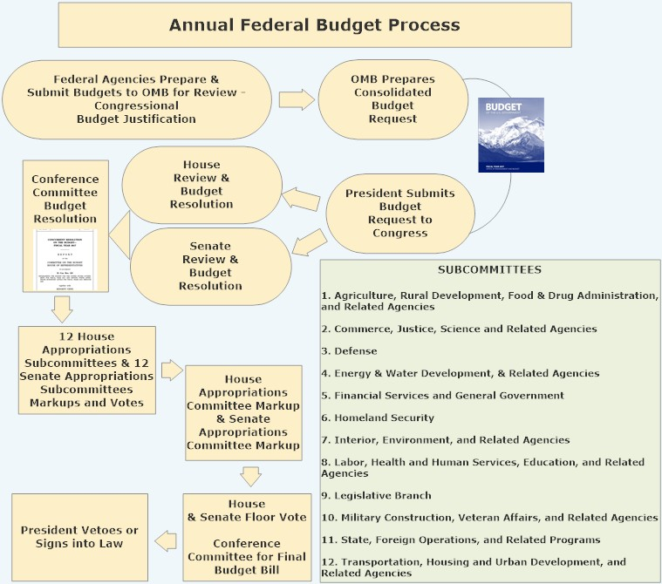
Notes:
Key Actions
Agencies Develop Strategies & Budgets – Congressional Budget Justification.
OMB Creates Consolidated Budget – President Submits to Congress.
House and Senate Appropriation Committees Drafts a Concurrent Budget Resolution.
Authorizing Committees Draft Required Legislation.
House and Senate Appropriations Committees Draft Final Budget and Congress Approves.
President Vetoes or Signs Final Budget Bill.

Slide 9
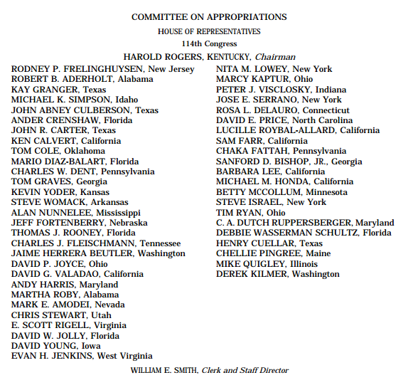
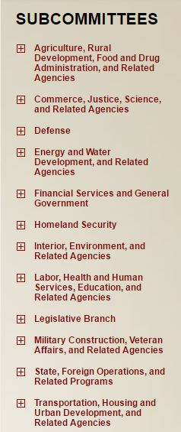
House Committee on Appropriations

Slide 10
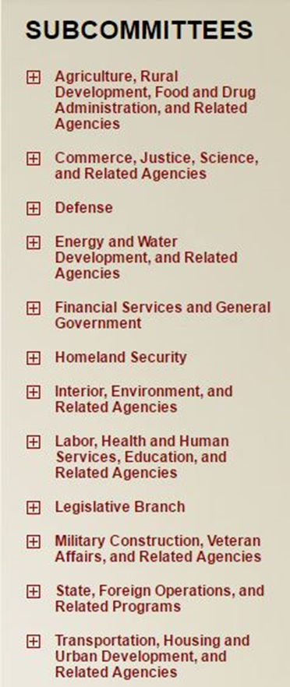
Senate Committee on Appropriations
Republicans
Chairman Thad Cochran
(R - MS)
Mitch McConnell (R-KY)
Richard Shelby (R-AL)
Lamar Alexander (R-TN)
Susan Collins (R-ME)
Lisa Murkowski (R-AK)
Lindsey Graham (R-SC)
Mark Kirk (R-IL)
Roy Blunt (R-MO)
Jerry Moran (R-KS)
John Hoeven (R-ND)
John Boozman (R-AR)
Shelley Moore Capito (R-WV)
Bill Cassidy (R-LA)
James Lankford (R-OK)
Steve Daines (MT)
Democrats
Vice Chairwoman
Barbara Mikulski(D - MD)
Patrick Leahy (D-VT)
Patty Murray (D-WA)
Dianne Feinstein (D-CA)
Richard Durbin (D-IL)
Jack Reed (D-RI)
Jon Tester (D-MT)
Tom Udall (D-NM)
Jeanne Shaheen (D-NH)
Jeff Merkley (D-OH)
Christopher Coons (D-DE)
Brian Schatz (D-HI)
Chris Murphy (D-CT)

Slide 11
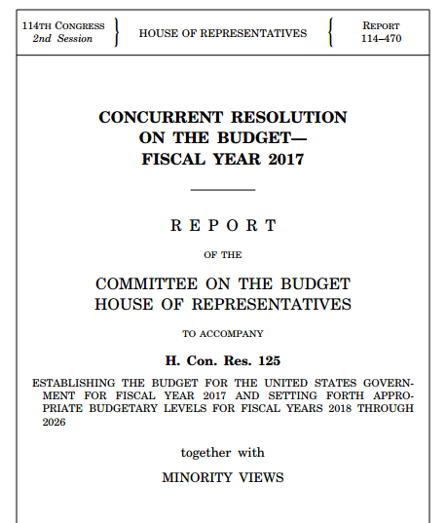
House Appropriations Concurrent Resolution on the Budget FY 2017
https://www.congress.gov/114/crpt/hrpt470/CRPT-114hrpt470.pdf

Slide 12
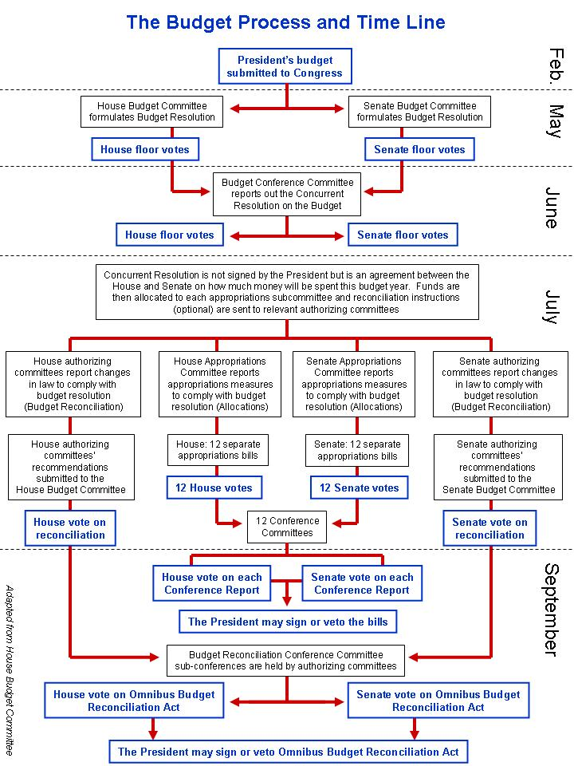
http://www.americangeosciences.org/policy/overview-fiscal-year-2017-appropriations

Slide 13
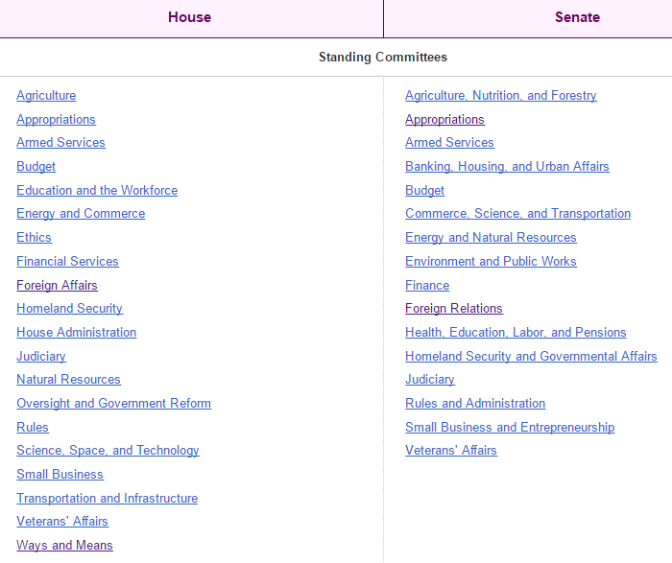
Congressional Committees
https://www.congress.gov/committees

Slide 14
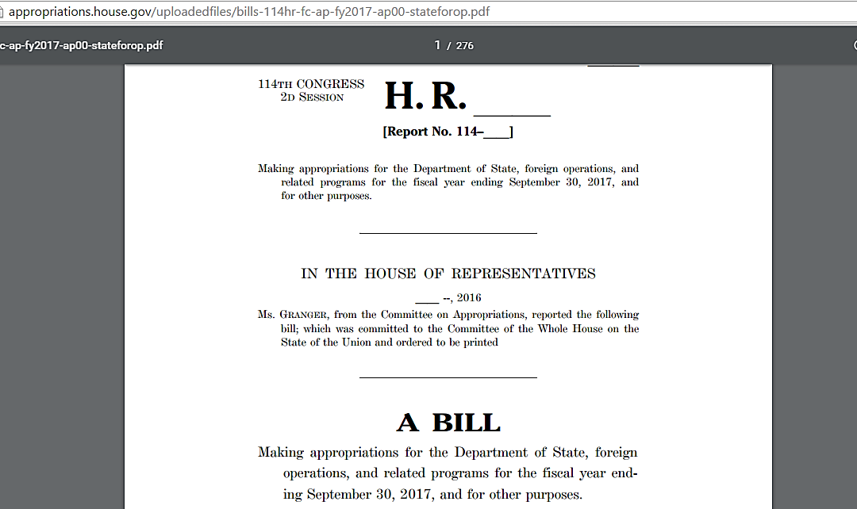
House Appropriations Subcommittee - State
Department, Foreign Operations and
Related Programs Bill
Passed by voice vote on July 12, 2016.
http://appropriations.house.gov/uploadedfiles/bills-114hr-fc-ap-fy2017-ap00-stateforop.pdf

Slide 15
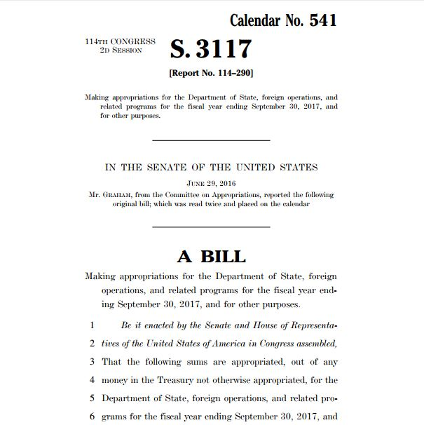
Senate Appropriations Subcommittee – State Department, Foreign Operations & Related Programs Bill
June 29, 2016 Vote In the Senate approved
this bill.
http://www.appropriations.senate.gov/imo/media/doc/FY2017-State-Foreign-Operations-Appropriations-Bill-S3117.pdf

Slide 16
President's FY 2017 Budget Request for the U.S. Department of State and USAID – Central America Strategy
Source: http://www.state.gov/r/pa/prs/ps/2016/02/252213.htm
“In our own Hemisphere, our budget ensures ongoing implementation of the U.S. Strategy for Engagement in Central America and dedicates over $750.6 million - as part of the Administration's $1.0 billion request for appropriations and financing assistance to Central America - to a long-term, comprehensive approach designed to address the underlying factors of migration of unaccompanied children and families. These whole-of-government efforts are geared toward promoting economic opportunities for the Central American people; building democratic, accountable, transparent, and effective public institutions; and providing a safer and more secure environment for citizens in the region.”
Secretary of State Kerry’s cover letter to the
Congressional Budget Justification for the 2017 State Department, Foreign Operations and Related Programs. Page. 4

Slide 17
U.S. Strategy for Engagement in Central America
Security
Economic Development
Governance
Promoting Police Reform
Improving Community Security
Continuing Defense Cooperation
Attacking Organized Crime
High-Level Security Dialogue
Strengthening Central American Institutions.
Promoting Trade Facilitation under Existing Free Trade Agreements.
Linking Central America to an Integrated North America.
Promoting Transport and Customs/Border Integration.
Promoting More Efficient and Sustainable Energy.
Reducing Poverty
Education and Workforce Development
Business Development
Increasing Resilience
Targeting Corruption
Investing in Civil Service Reform
Improving Fiscal Capacity
Increasing the Role of Civil Society
Strengthening Judicial Institutions
Reinforcing Democratic Institutions
https://www.whitehouse.gov/sites/default/files/docs/central_america_strategy.pdf

Slide 18
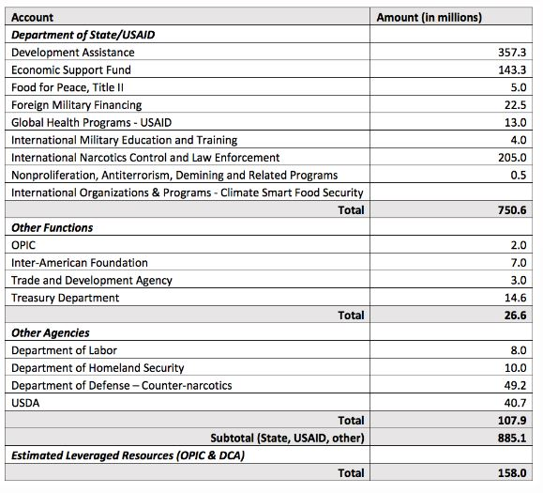
U.S. Strategy for Engagement in Central America Funding
150 Account
https://www.wola.org/analysis/whats-in-the-administrations-2017-central-america-aid-request/

Slide 19
House Appropriations Subcommittee - State
Department, Foreign Operations and
Related Programs Bill – Central America Narrative
WESTERN HEMISPHERE SEC. 7045. (a) UNITED STATES ENGAGEMENT IN CENTRAL AMERICA.—FUNDING.—Up to $750,000,000 may be made available for assistance for countries in Central America to implement the United States Strategy for Engagement in Central America in support of the Plan of the Alliance for Prosperity in the Northern Triangle of Central America.
Provided, that the Secretary of State and Administrator of the United States Agency for International Development (USAID) shall prioritize such assistance to address the key factors in such countries contributing to the migration of unaccompanied, undocumented minors to the United States.
http://appropriations.house.gov/uploadedfiles/bills-114hr-sc-ap-fy2017-transhud-subcommitteedraft.pdf

Slide 20
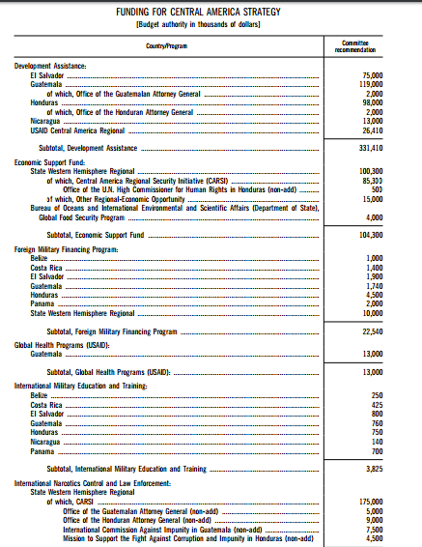
Senate Appropriations Subcommittee – State Department, Foreign Operations & Related Programs Bill – Central America Narrative
CENTRAL AMERICA The Committee recommends a total of $650,575,000 to implement the U.S. Strategy for Engagement in Central America in support of the Plan of the Alliance for Prosperity in the Northern Triangle of Central America.
http://www.appropriations.senate.gov/imo/media/doc/FY2017-State-Foreign-Operations-Appropriations-Report114-290.pdf
DA - $331 million; ESF – $104 million; FMF - $23 million; Global Health - $13 million; IMET - $4 million; and INCLE - $175 million. Total - $650.6 million

Slide 21
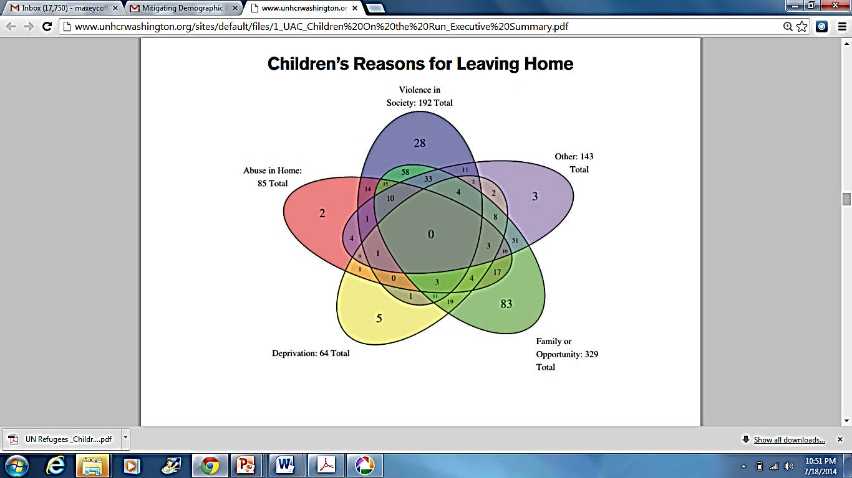
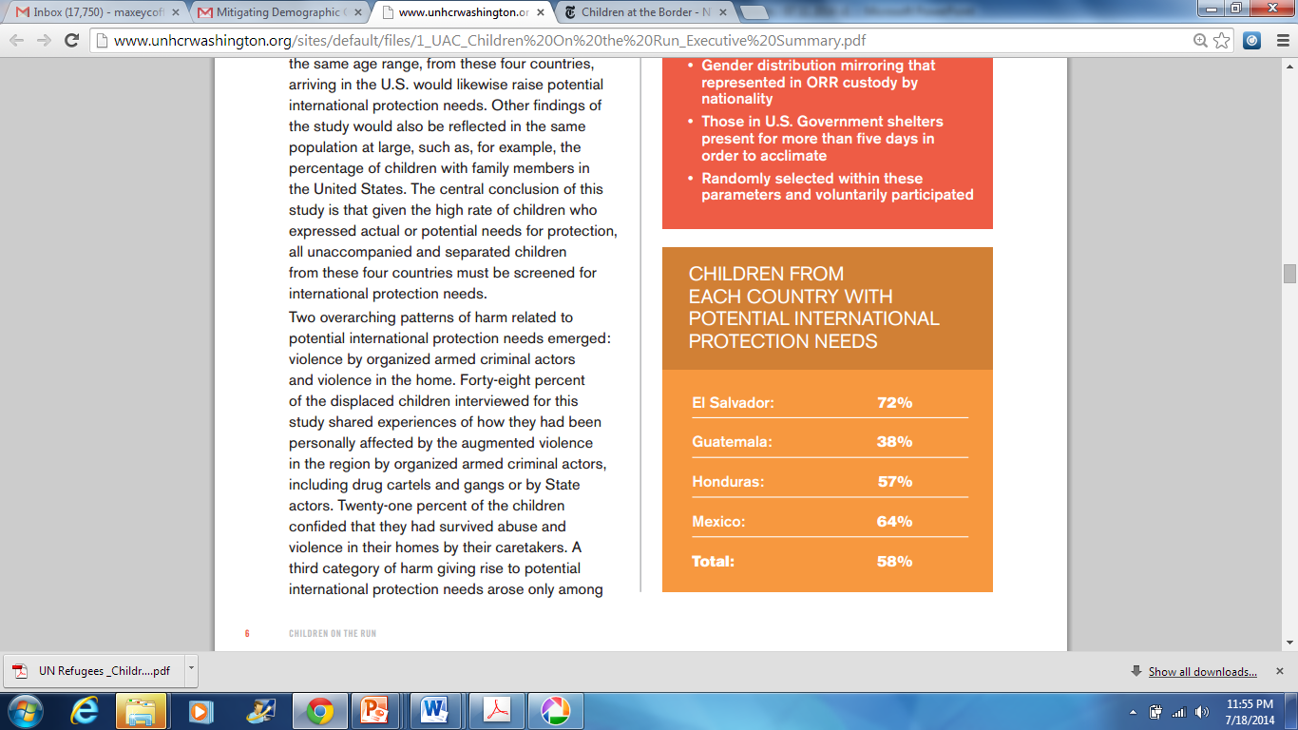
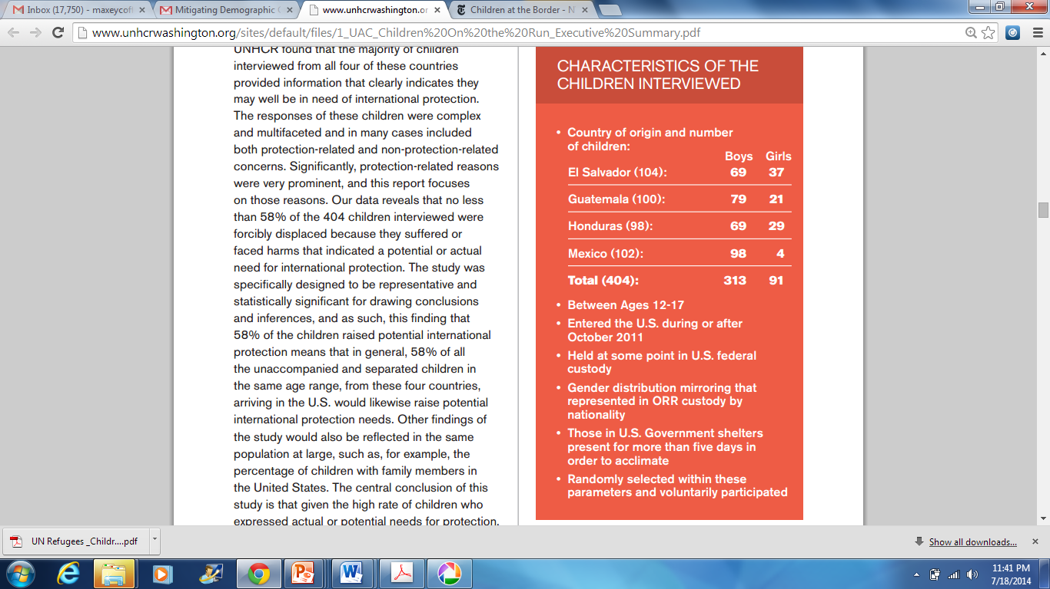
“Children on the Run” Unaccompanied Children Leaving Central America & Mexico
The UN Refugee Agency (UNHRC) Study
2014 http://www.unhcrwashington.org/
Apprehensions of unaccompanied and separated children arriving to the United States from El Salvador, Guatemala and Honduras has increased significantly.
FY 2010 – 4,059
FY 2011 - 10,443
FY 2012 - 21,537
FY 2014 – 66,115
FY 2015 – 35,485
FY 2016 – 54,052*
*through August 2016

Slide 22
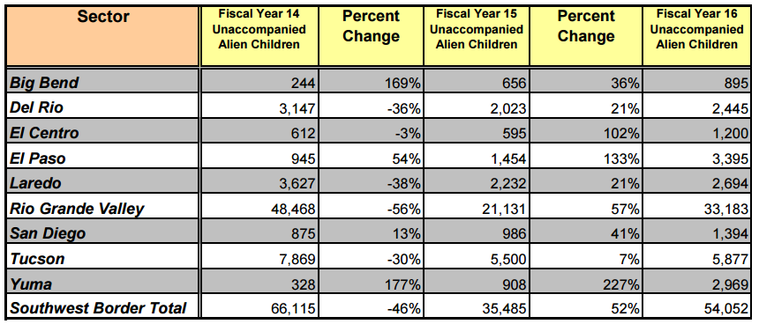
Homeland Security – Customs and Border Protection
Unaccompanied Alien Children – FY 2014 – FY 2015 – FY 2016 (through August 2016)
FY 2016 UACs increased 52% over the FY 2015 number.

Slide 23
How this all comes together to make Central American immigration to the US self-perpetuating.
Cumulative Causation
Self-perpetuating
Migration
Networks
Critical Threshold
Cumulative causation of migration leads to a situation in which networks are formed creating connections between family, peers and colleagues in origin and destination communities. When these networks reach a critical threshold, migration becomes self-perpetuating because each act of migration creates the social structure needed to sustain it.
"Each act of migration creates social capital among people to whom the migrant is related, thereby raising the odds of their migration."
Beyond Smoke and Mirrors
Douglas Massey
Notes:
Neoclassical Economics - Two aspects of motivation of immigration is the macro-economic aspects of wages, availability of capital vs labor, and the micro-economic aspects of personal decisions on the benefit vs the costs of emigrating to another country. Differences between two countries in supply and demand for labor in relation to capital creates the conditions for high wages when one country has a large endowment of labor (Mexico & Central America) relative to capital vs a country with a high endowment of capital relative to labor (US). The higher wage paid in the US becomes one of the drivers for out migration from Mexico and Central America. Key aspect of this model is "Expected Destination Earnings" which is the propensity to move (expected wage in destination country multiplied by the probability of obtaining and holding a job there) minus local earnings and cost of move times the probability of getting a job locally. Under the Neoclassical Economic Model, migration should not occur in the absence of a wage differential and employment is available in both countries.
New Economics of Labor Migration - In this line of theoretical reasoning, unlike the neoclassical model, it does not assume that migration decisions are made by isolated actors but that they are taken within larger units of interrelated people, typically families but sometimes entire communities. Within these communities, people not only act individually to maximize expected income but also work collectively to overcome failures in capital, credit, and insurance markets. Managing this risk requires diversifying their allocation of productive resources; one of those resources is their labor. The inadequacy of banking and insurance institutions create a situation where migrants seek to offset risk by working to send remittances to their family.
World Systems Theory - Social and economic structures impact the decisions made by individual through fundamental changes in market opportunities. As world markets change through economic globalization the changes create situations that can drive out migration. For example, the passage of NAFTA, resulted in increased competition for small scale farmers in developing countries in basic grain production. Over time rural residents find that they can not compete with the low price of imported grain. Lacking an alternative to basic grain production these farmers are forced to leave their land migrating first to urban areas and then, in many case, to a developed country. In the case of Mexico and Central America, this situation arose as free trade regimes were implemented with the US.
Demand Driven Migration - The Segmented Labor Market theory by Michael Piore argues that international migration is caused by "pull factors" in receiving societies which are in chronic and unavoidable need for low wage workers. This need for low wage workers is driven by (1) structural inflation - the avoidance of raising the wage on entry level workers would cause inflation through the whole wage structure, so it is avoided, (2) social status - local workers do not want to do certain jobs that are seen as below their social standing, (3) labor vs capital - enterprises want low wage labor that can be reduced in tough economic times vs capital intensive labor that is harder to reduce, and (4) lack of entry level labor (traditionally this was supplied by students and women but that population has largely entered the workforce in the US over the last 40 years -- new entry level workers are needed).
"The same processes that operate globally to create migrants by
making it easier for them to migrate to the developed world."
Various theories of migration predict outcomes at different levels of aggregation thus they can build on each other depending on the conditions and stage of immigration history of the countries involved. All of the theories can work together -- (1) individuals can engage in cost benefit analysis, (2) seek ways to overcome risks and gain access to capital, (3) utilize social capital from community networks, and (4) respond to demand for entry level labor. The cumulative causation of migration leads to a situation in which networks are formed creating connections between family, peers and colleagues in origin and destination communities. When these networks reach a critical threshold, migration becomes self-perpetuating because each act of migration creates the social structure needed to sustain it.
"Social Capital is the sum of the resources, actual or virtual, that accrue to
an individual or a group by virtue of possessing a durable network of more or less
institutionalized relationships of acquaintance and recognition."

Slide 24
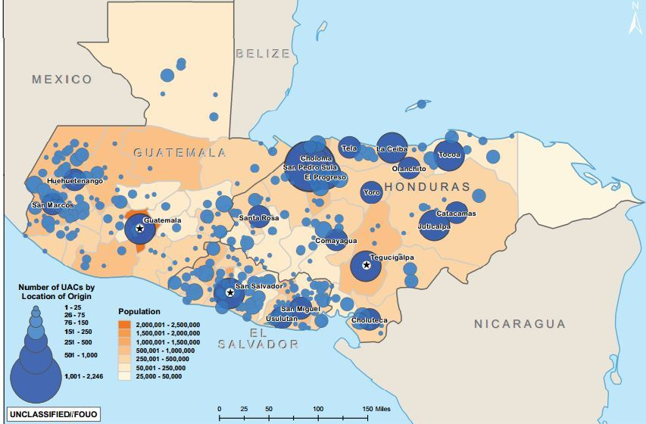

Slide 25
U.S. Destination Communities for Unaccompanied Alien Children from Northern Triangle
Each dot
Represents
2,500 Northern
Triangle Origin
Residents

Slide 26
UAC Sponsored in Virginia from October 2013 to July 2016
Office of Refugee Resettlement
Source: http://www.acf.hhs.gov/programs/orr/unaccompanied-children-released-to-sponsors-by-county
2014 2015 2016
Arlington 179 87 124
Fairfax 1373 560 1048
Loudon 72 0 177
Prince William 504 231 454
Alexandria City 259 106 155
Manassas City 132 0 82
UACs in
Northern Virginia
Arlington -390
Fairfax – 2,981
Loudon – 249
Prince William – 1,189
Alexandria City – 520
Manassas City - 214
2014
2015
2016
* The cost of public education in Fairfax County is $14,432/student/year per Fairfax County School System FY 2017 budget (see https://www.fcps.edu/sites/default/files/media/pdf/FY17Approved%20Budget_0.pdf ). ESOL teachers represent 2 teacher equivalent positions based on information obtained from the Fairfax County Tax Alliance.

Slide 27
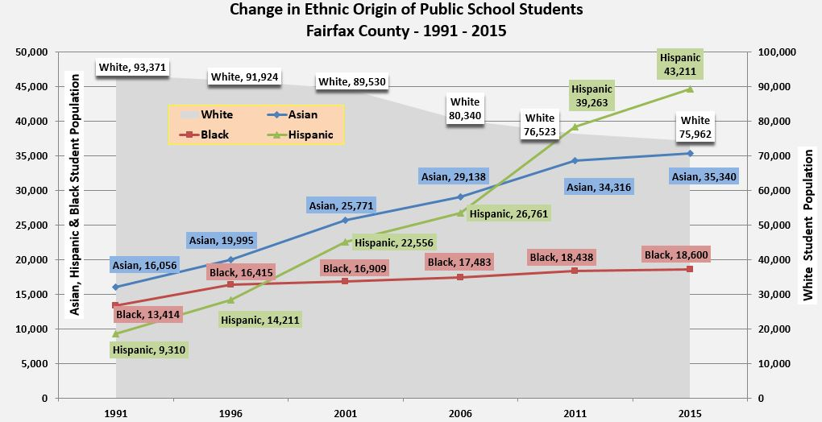

Slide 28
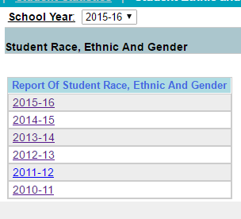
Fairfax County Public School System
FCPS Demographic Data: 2010 - 2015
“Since FY 2008, FCPS’ enrollment has consistently increased, resulting in FCPS being the tenth largest school system in the United States. The increase in the number of FCPS’ students in the eight years is almost the size of Arlington County Public Schools’ total enrollment. While experiencing significant enrollment growth and changes in student demographics, revenues have not kept pace with expenditures.”
http://schoolprofiles.fcps.edu/schlprfl/f?p=108:108:1055042135019::NO::P0_CURRENT_SCHOOL_ID:390
Source: FY 2017 Budget Task Force Recommendations to the Superintendent
https://www.fcps.edu/sites/default/files/media/pdf/FY%202017%20BTF%20Final%20Report%20Revised%201-20.pdf

Slide 29
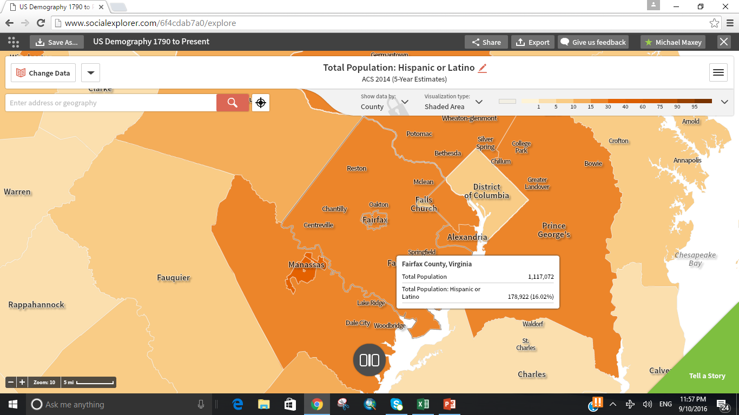
Hispanic Population
178,922 – 16% of
Total Population
Fairfax County, VA

Slide 30
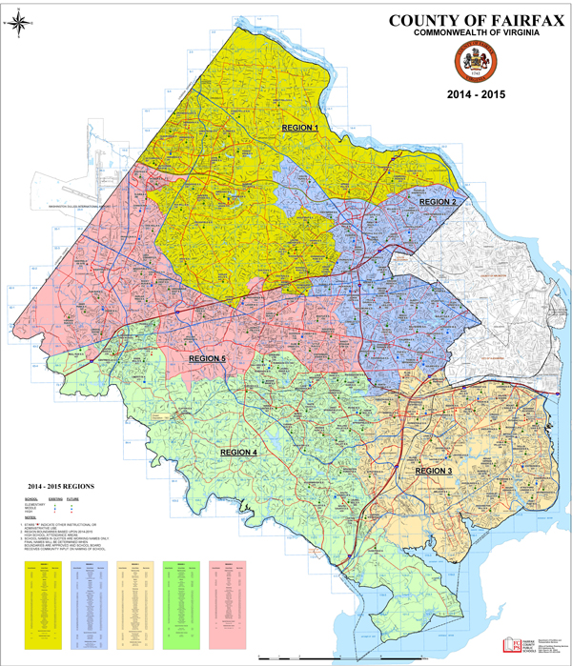
Mapping Demographic Change in Fairfax County
Fairfax County High Schools
with over 30% Hispanic
Student Body
Region 1
Herndon HS
Region 2
Hispanic Student
Population by Region
Region 1 – : Herndon HS; Langley HS; Madison HS; Oakton HS; South Lakes HS.
Region 2 – Annandale HS; Falls Church HS; Marshall HS; McLean HS; Stuart HS.
Region 3 – Edison HS; Hayfield SS; Lee HS; Mount Vernon HS; West Potomac HS.
Region 4 – Centreville HS; Lake Braddock SS; Robinson SS; South County HS; West Springfield HS.
Region 5 – Chantilly HS; Fairfax HS; Westfield HS; Woodson HS.
Annandale HS
Falls Church HS
Jeb Stuart HS
Edison HS
Lee HS
Mount
Vernon HS
West Potomac
HS
Region3

Slide 31
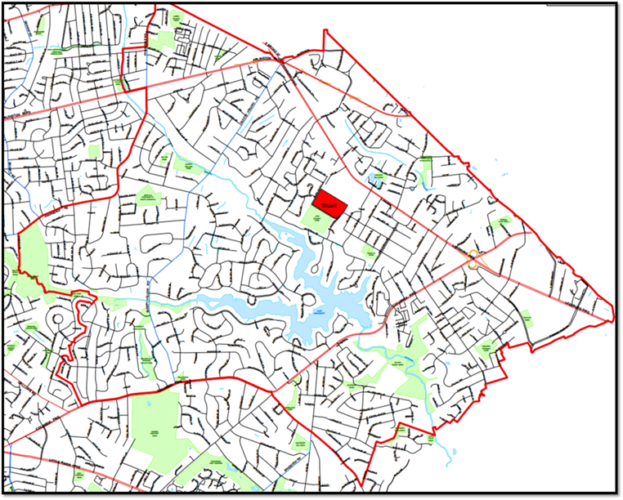
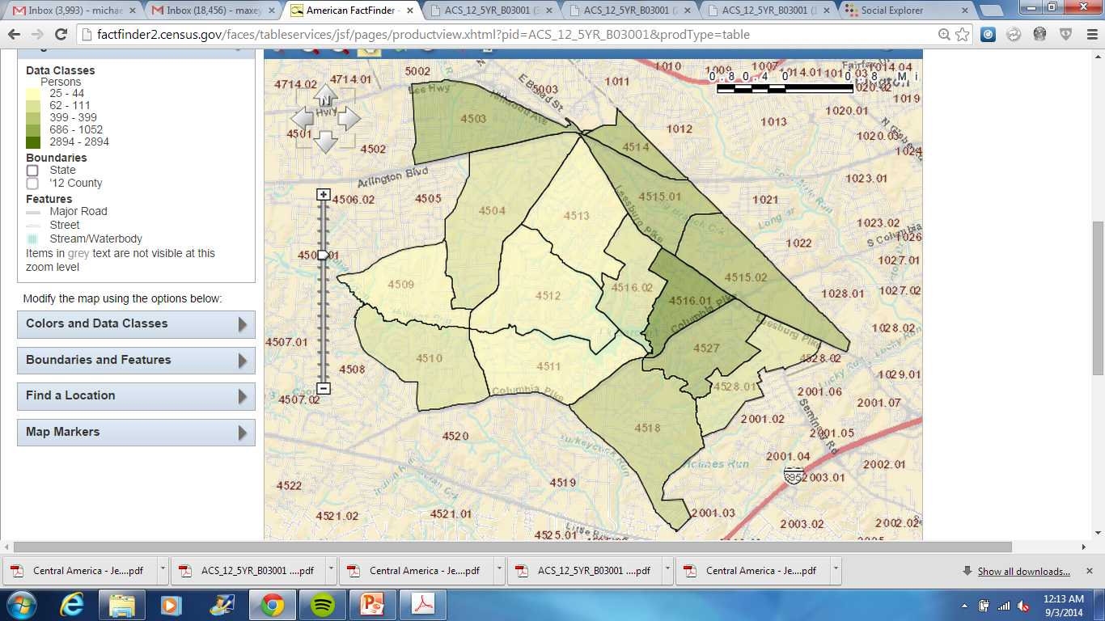
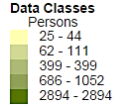
Hispanic Residents within Jeb Stuart HS Boundary
Source: US Census – American Community Survey 5 Year Estimate 2007 - 2012
There are 17,549
Hispanic Residents (31% of total population) in the
Jeb Stuart HS Boundary.
There are 56,401 residents in the Census Tracts comprising the Jeb Stuart HS boundary.
Census Tract 4503
Census Tract
4514
Census Tract
4504
Census Tract
4513
Census Tract
4515.01
Census Tract 4516.02
Census Tract
4516.01
Census Tract 4509
Census Tract
4515.02
Census Tract 4512
Census Tract 4527
Census Tract 4510
Census Tract
4511
Census Tract 4528.01
Census Tract 4518
Hispanics by Census Tract in the Jeb Stuart HS Boundary
American Community Survey 5 Year Estimate 2007 – 2012
Table B03001 – Hispanic or Latino – Central American Origin
Census Tract 4503 – 4504 – 4509 – 4510 – 4511 – 4512 – 4513 – 4514 – 4515.01 – 4515.02 – 4516.01 – 4516.02 – 4818 – 4527 – 4528.01 – 4528.02 – | Total Population 4,746 2,690 1,587 2,472 2,193 1,749 2,320 2,942 5,623 4,557 5,699 3,002 3,575 5,343 4,931 2,972 56,401 | Hispanic Population 1,632 438 362 393 436 125 331 1,415 2,067 1,623 4,114 442 1,294 1,796 793 288 17,549 | Central American Origin Population 686 62 27 66 44 25 36 690 894 720 2,894 75 399 1,052 111 108 7,889
There are 7,889 Central American
Residents (14% of total population, and 45% of the Hispanic population) in the
Jeb Stuart HS Boundary.

Slide 32
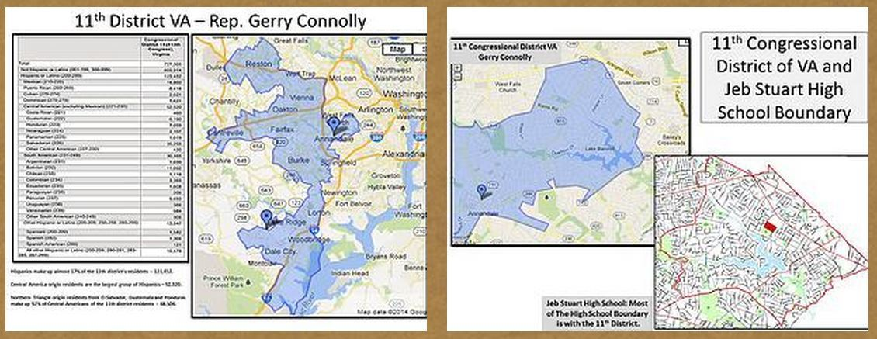
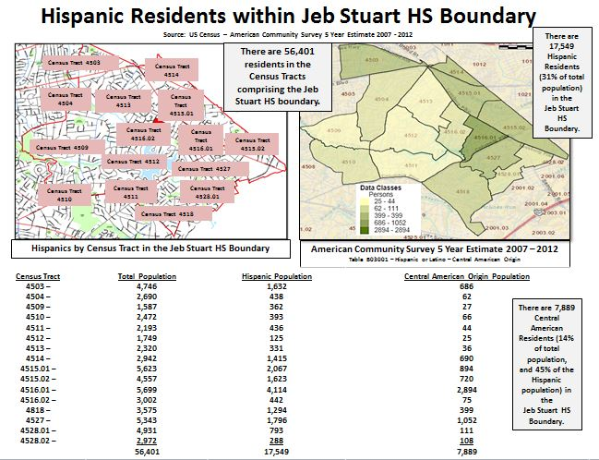
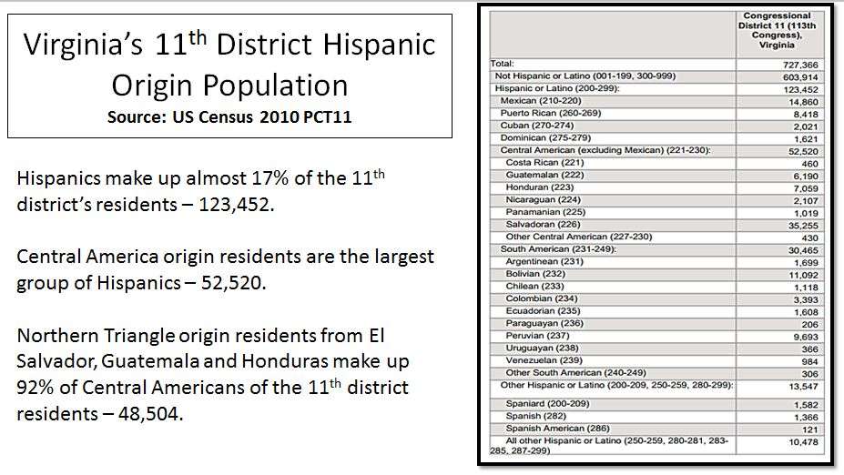
VA 11th Congressional District vs Jeb Stuart High School

Slide 33
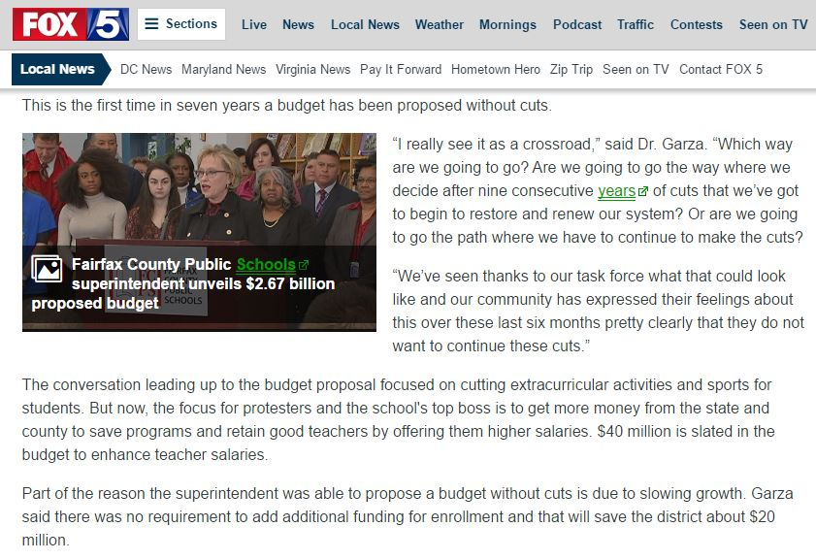
Fairfax County School System Seeks to Cover Budget Shortfall with Meal Tax of 4 Percent

Slide 34
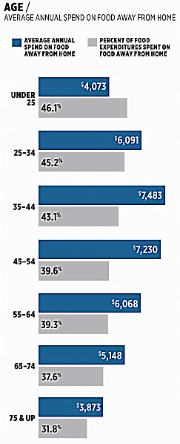
Fairfax County is requesting voters to approve a meal tax of 4% which will support the Fairfax County School Budget. This tax is projected to raised approximately $90 million in revenue.
“Millennials go out to eat more often than Gen X or Baby Boomers, according to the analysts. 53% of the group goes out to eat once a week, compared with 43% for the general population.”
Consumer Expenditure Data - Bureau of Labor Statistics 2015 - Source: http://www.bls.gov/cex/tables.htm
https://www.qsrmagazine.com/consumer-trends/meet-your-consumer

Slide 35
Questions?

