Slide 1
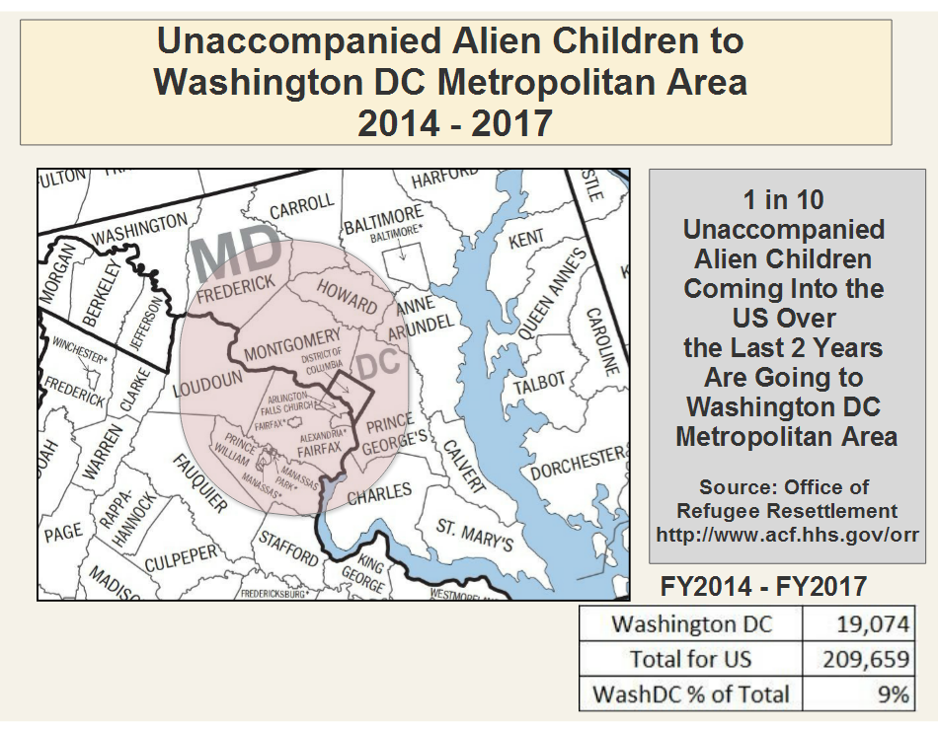
Washington DC Metropolitan Area
Almost 20,000 Unaccompanied Alien Children (UACs) primarily from El Salvador, Guatemala and Honduras arrived in the Washington DC Metropolitan Area from FY2014 – FY2017.

Slide 2
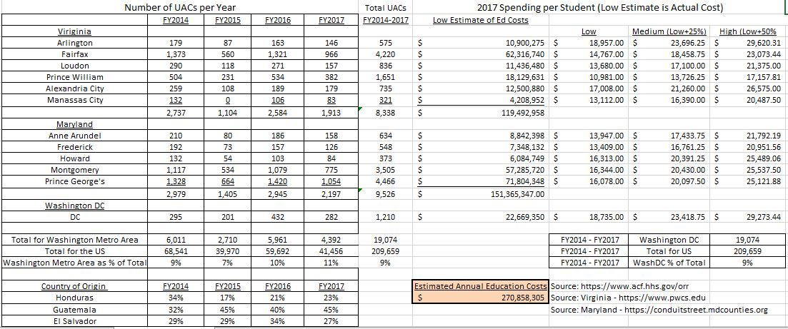
UACs: Washington Metro Area – Demonstrating the Stake that US Communities Have in Successful Outcomes in Honduras, El Salvador and Guatemala.
Honduras spends
US$647 per student.
Cost per
Student.
Washington DC Metro
Education Costs

