Slide 1
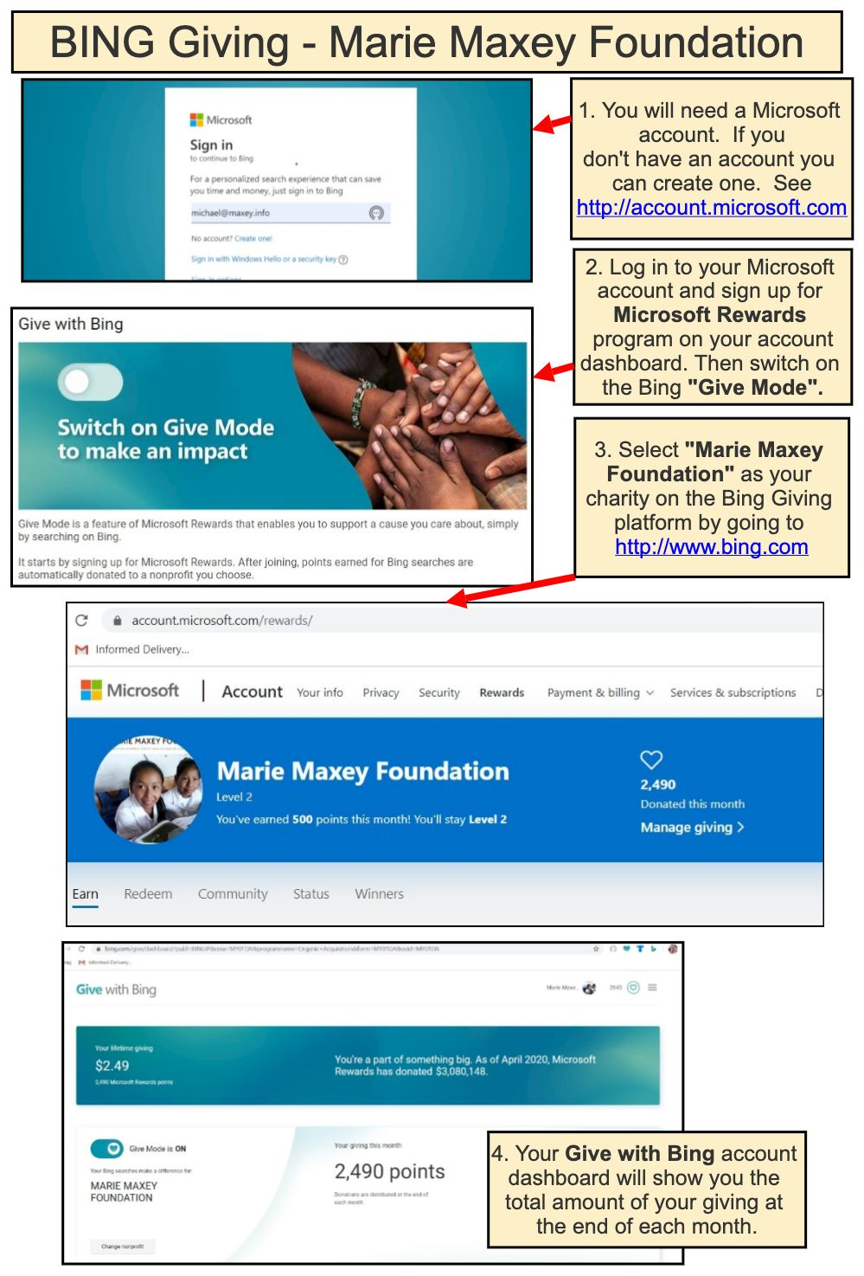
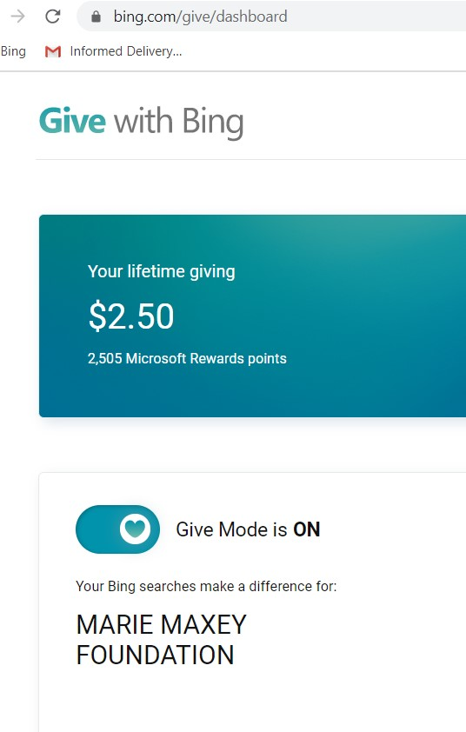
4. See your giving total via Bing Giving at the end of each month –https://www.bing.com/give/dashboard.
1. Create and/or log in to
Your Microsoft account
http://account.Microsoft.com
2. Sign up for Microsoft Rewards by clicking on the link
https://account.microsoft.com/rewards/
3. Switch to Give Mode at Give with Bing by clicking on the link https://www.bing.com/give/dashboard

